Slide 1


Slide 2
Course Objectives
Understand the basics of Adobe Photoshop's interface
Learn about key tools and features for image editing and design
Gain hands-on experience through practical exercises

Slide 3
About Today…
Intro to Photoshop
Installation
Workspace

Slide 4
Importance of Photoshop
Graphic design
Widely used in graphic design for creating and editing visual elements
Logos
Posters
Manipulate images
Brochures
Add effects
Business cards
Create appealing designs
Adjust colors

Slide 5
Importance of Photoshop
Photography
Staple tool enabling photographers to enhance, retouch, and manipulate photographs
Color correction
Creating composite images
Adjust exposure
Applying filters
Removing blemishes

Slide 6
Importance of Photoshop
Digital art
Favorite among digital artists to create appealing arts
Illustrations
Paintings
Brush
Digital compositions
Texture
Blending mode

Slide 7
Importance of Photoshop
Web design
Plays a crucial role in web design to make website attractive and joyful
Website layouts
Graphics
Interfaces
Optimized images
Mockups
Prototypes
Buttons
Icons

Slide 8
Key Features
Layers
Non-destructive editing
Organizing elements
Filters
Applying creative effects
Adjustments
Tools
Selection
Painting
Retouching

Slide 9
Industry Usage
Advertising agencies
Photography studios
Design firms
Media companies

Slide 10
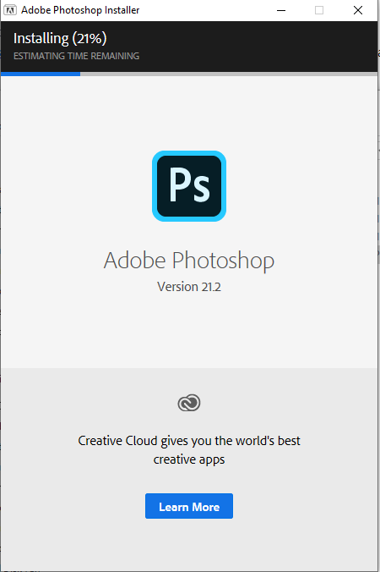
Installation

Slide 11
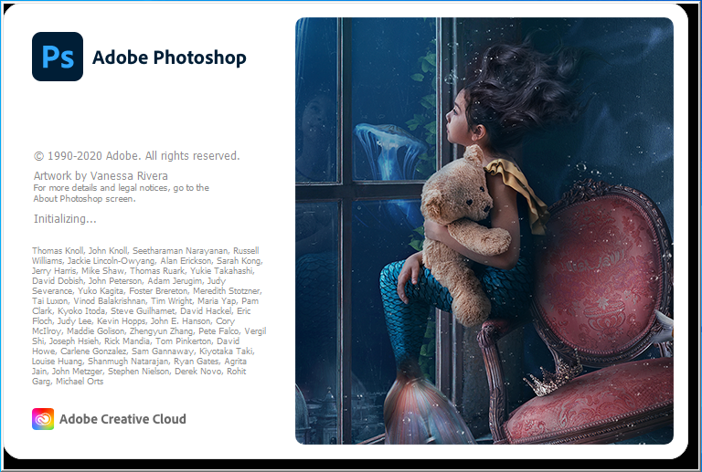

Slide 12
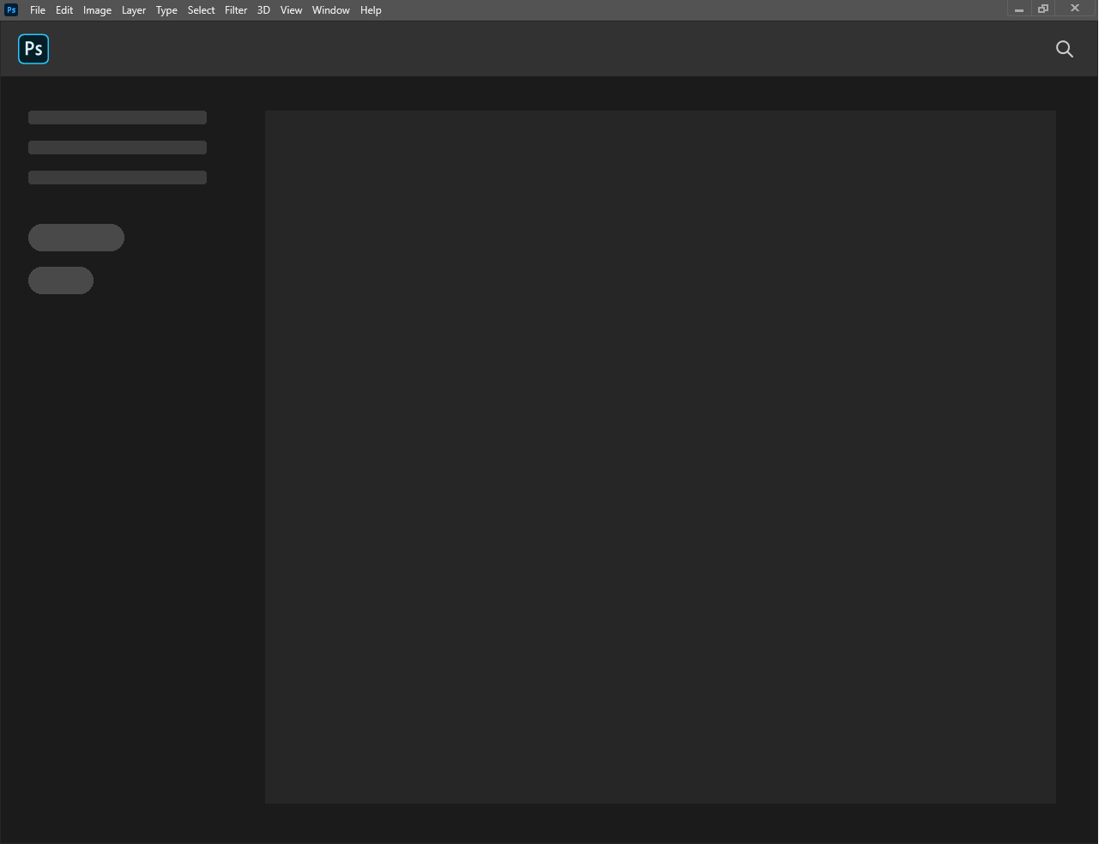

Slide 13
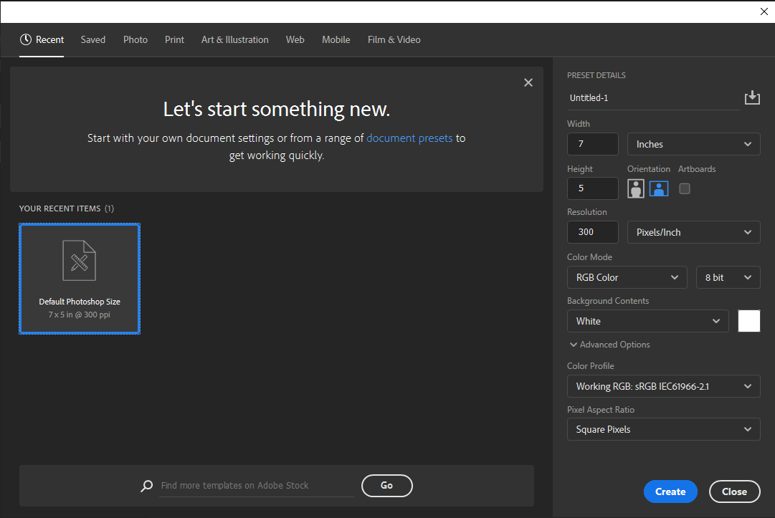

Slide 14
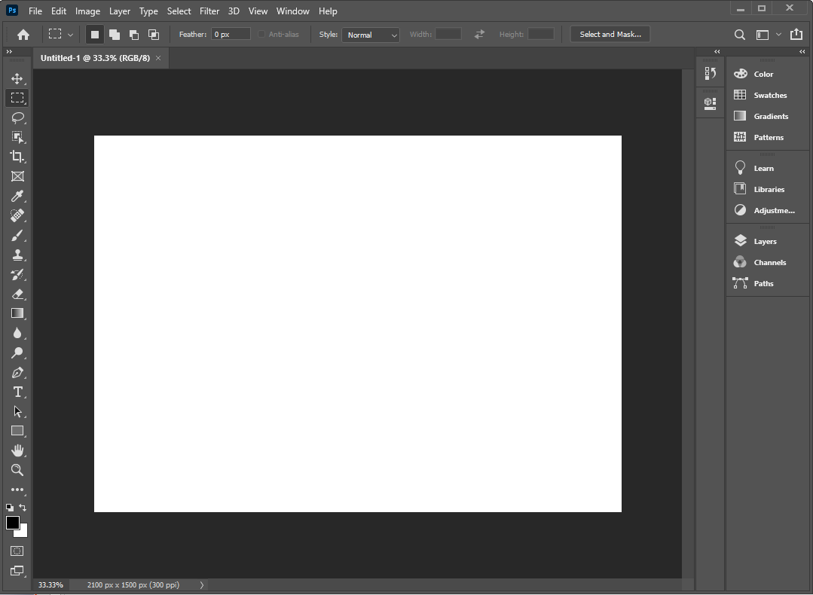

Slide 15
Menu bar
Provides access to various commands and features organized into different menus
File
New, Open, Save, Export, etc.
Edit
Undo, Redo, Cut, Copy, Paste, etc.
Image
Adjustments, Image Size, Canvas Size, etc.
Layer
Create, Duplicate, Merge, etc.
Select
Select All, Deselect, Inverse, etc.
Filter
Apply filters and effects.
View
Zoom, Actual Pixels, Fit Screen, etc.
Window
Manage panels and workspaces.

Slide 16

Tool bar
Contains tools for performing various actions
Move Tool
Move and transform objects
Marquee Tools
Make selections
Lasso Tools
Precise selections
Crop Tool
Crop and straighten images
Brush Tool
Paint and edit with brushes

Slide 17
Options bar
Displays options and settings for the currently selected tool in the Tool Bar, allowing users to customize tool behavior and perform specific actions
Display options related to the selected tool
Options bar changes based on tool selection

Slide 18
Panels
House different sets of tools, settings, and features related to specific tasks
Layers
Manage layers, adjust opacity, blending modes
Properties
Adjust layer properties and effects
History
Undo/redo actions and step back in history
Navigator
Navigate large images and zoom levels

